Slide 1

Group 7 Library Application
Jeffrey metz - 111435
Osama Quttriyeh – 617575
Hoang tin Nguyen - 618682

Slide 2
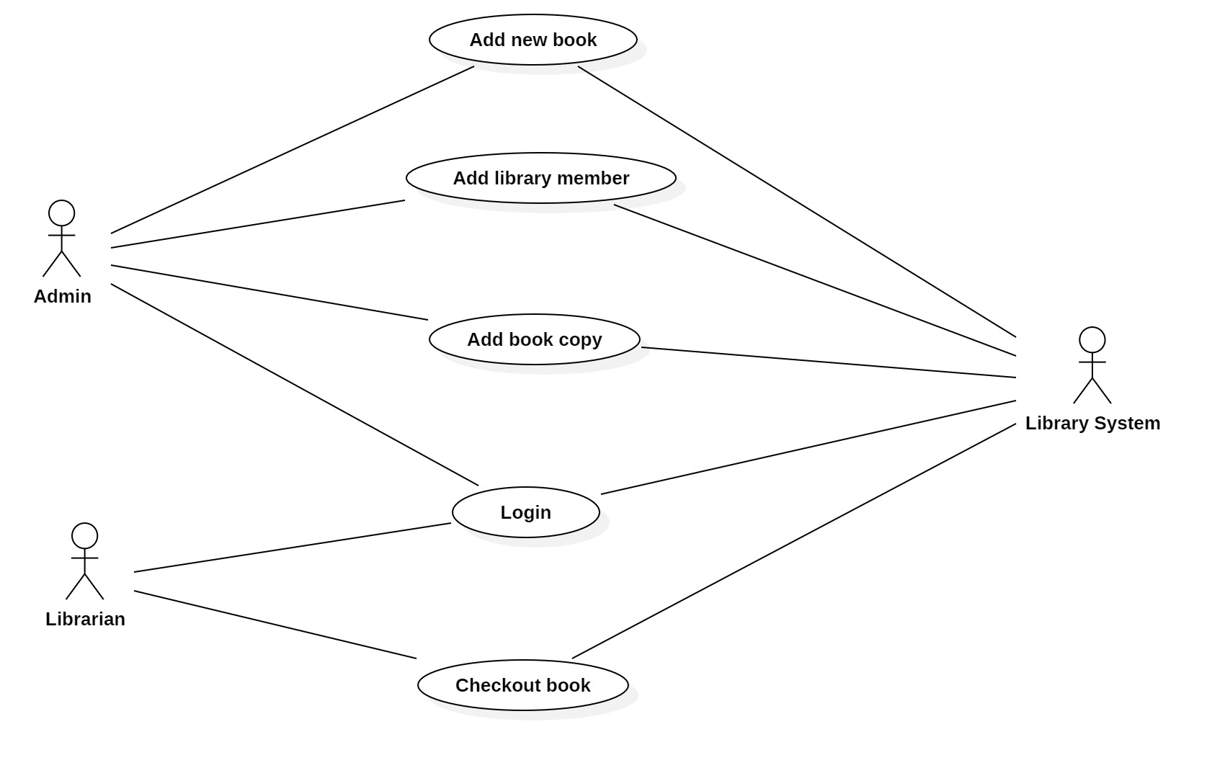
Use case diagram

Slide 3
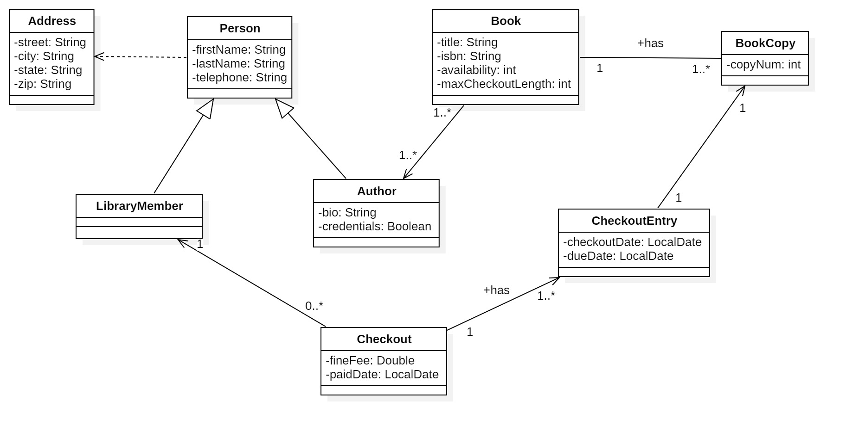
Class diagram

Slide 4
Sequence diagram 1 – Checkout book

Slide 5
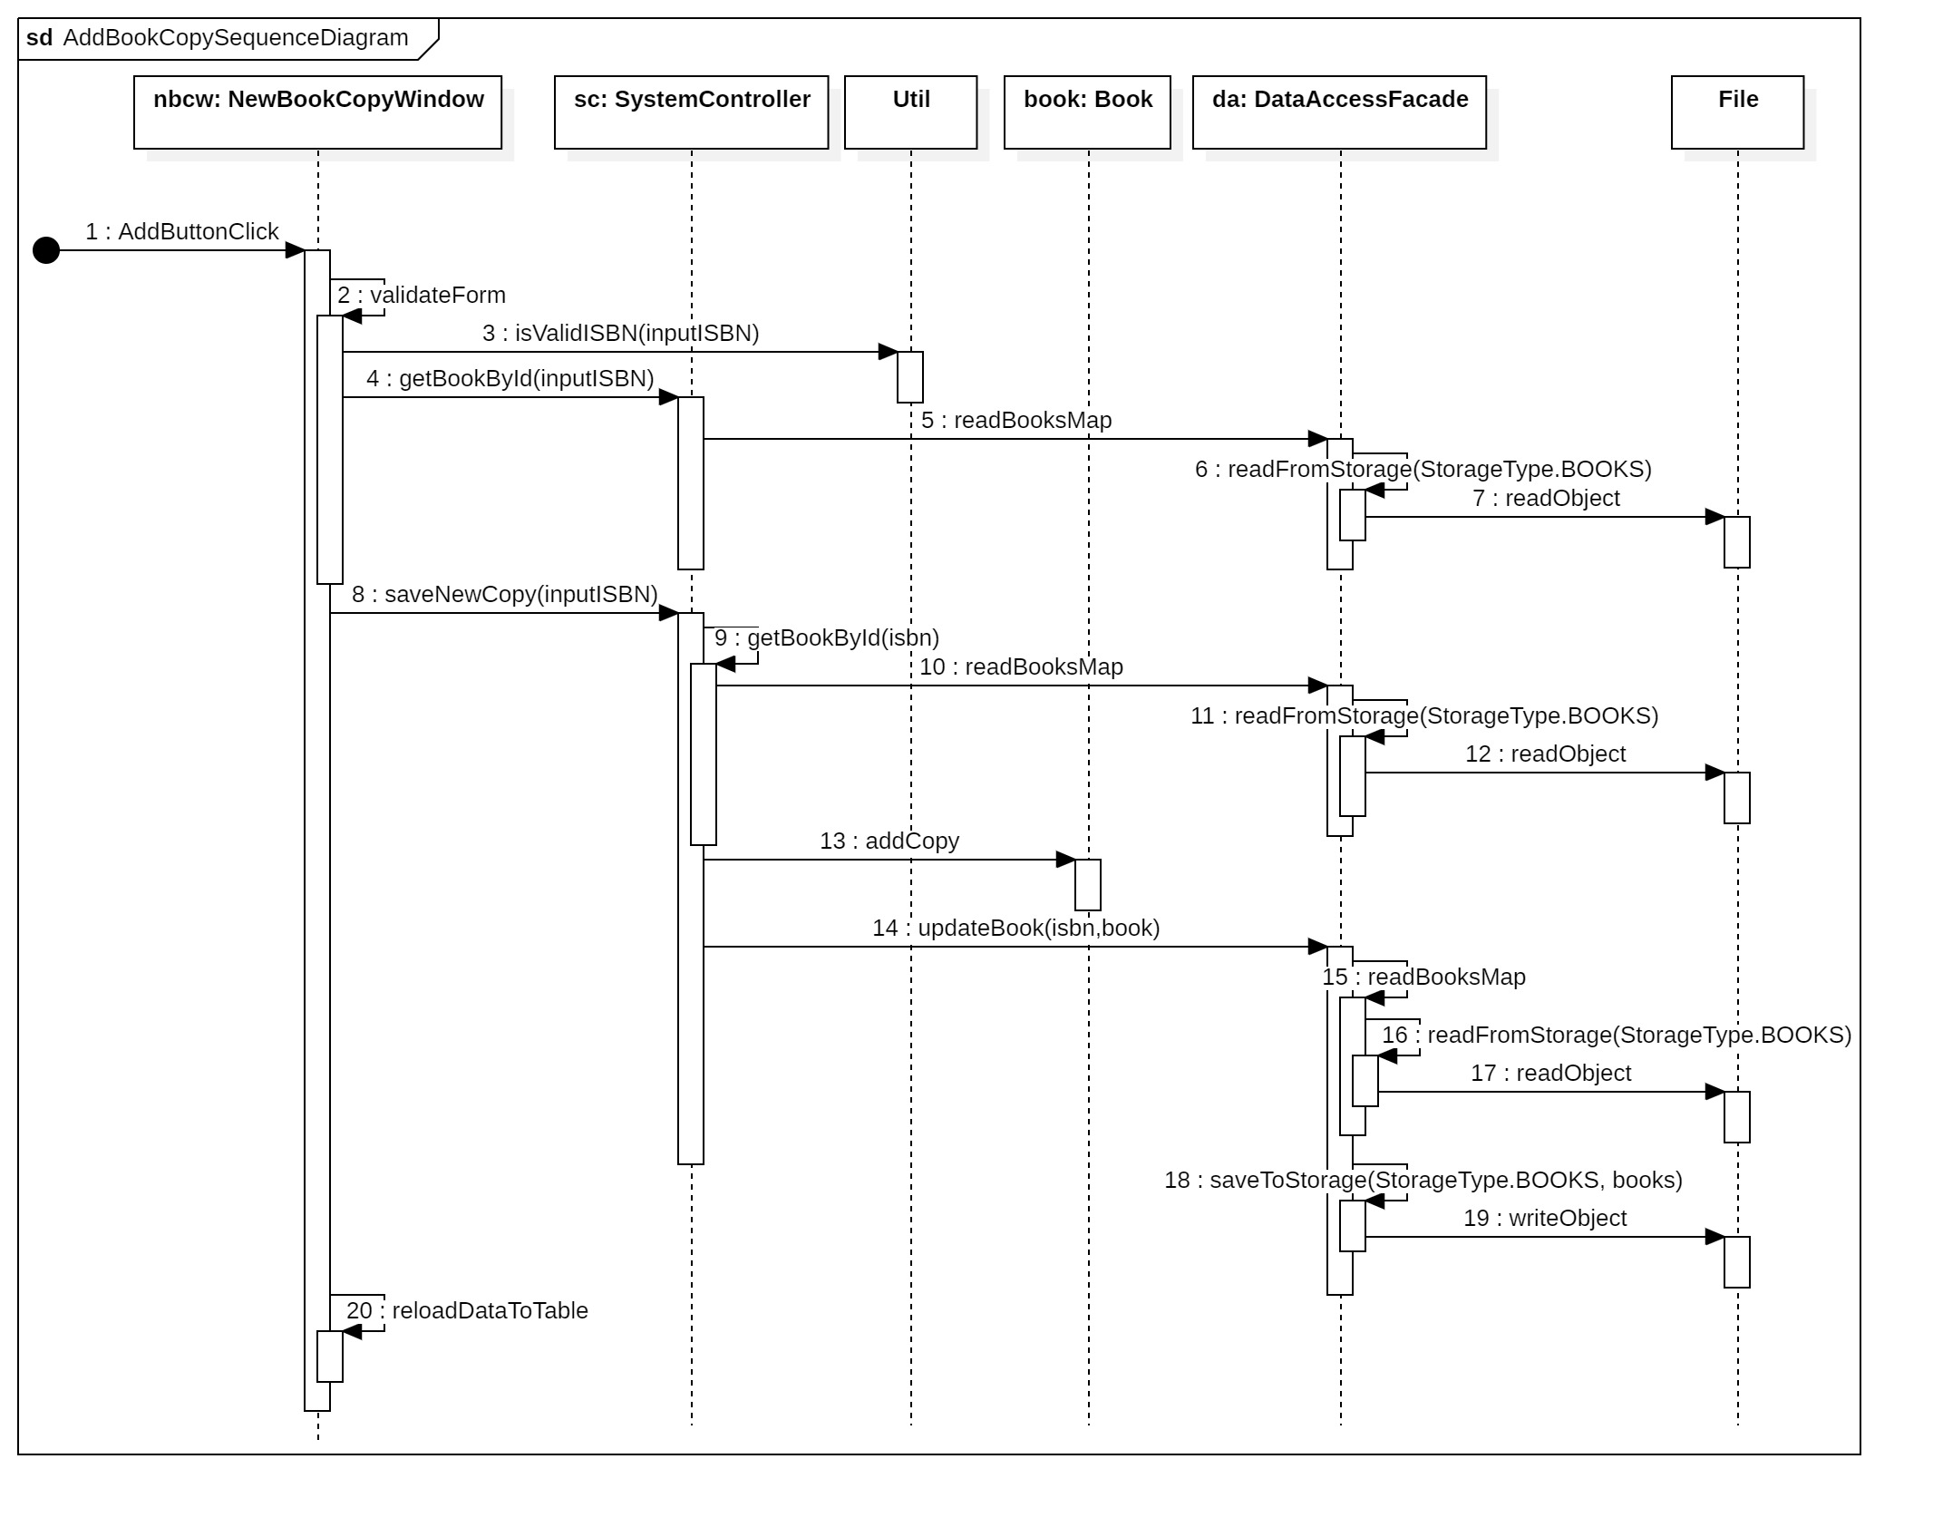
Sequence diagram 2 – Add book copy

Slide 6
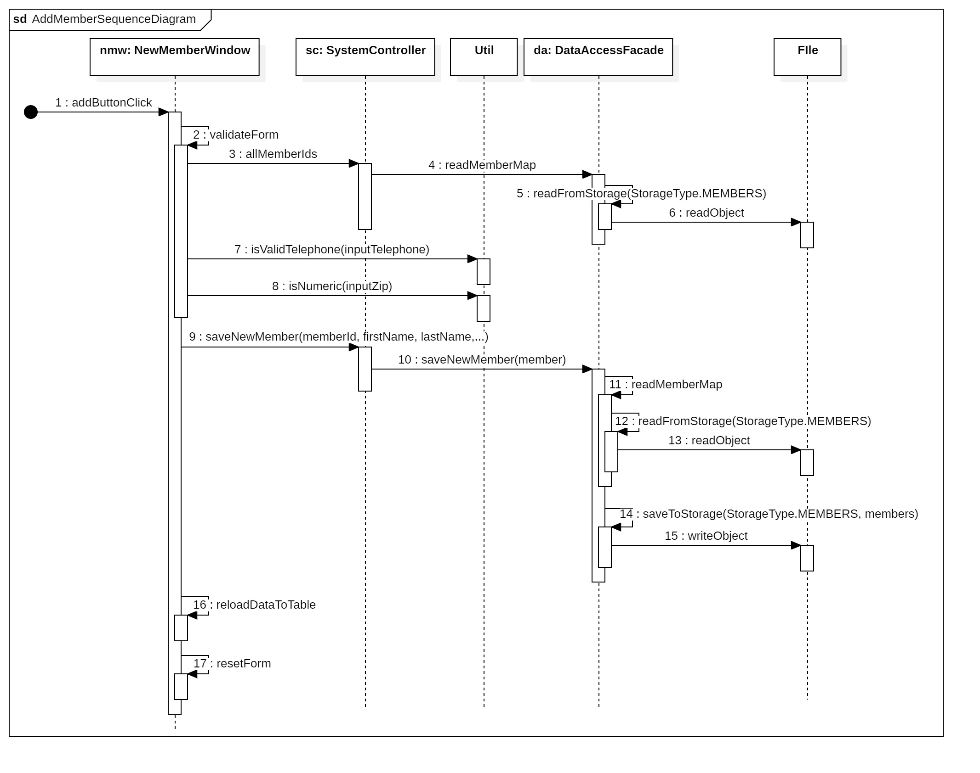
Sequence diagram 3 – Add member

Slide 7
Validation rules

Slide 8
Demo
JDK 22
IDE: IntelliJ
https://github.com/venturousman/miu-mpp-library

Slide 9

Thanks for listening
This Photo by Unknown Author is licensed under CC BY-SA

Slide 10

Q&A
This Photo by Unknown Author is licensed under CC BY-NC

